Slide 1
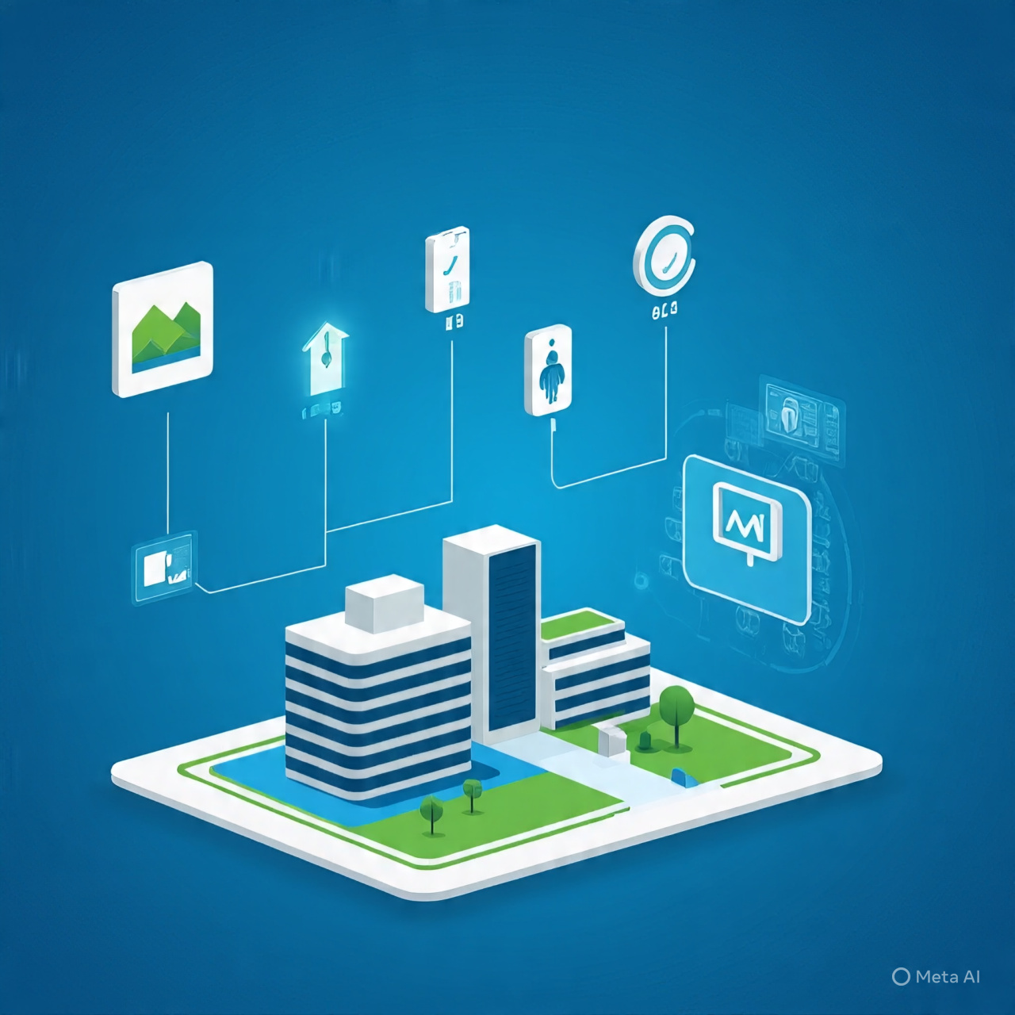
IoT-Based Smart Building Monitoring and Control System
Presenters:
MN. Sihanas
AJ. Nishak Mohammed

Slide 2
Introduction
The advancement of the Internet of Things (IoT) has enabled the development of intelligent systems that can monitor, control, and automate various aspects of building infrastructure.
Smart buildings integrate multiple sensors and devices to ensure safety, improve energy efficiency, and enhance comfort for occupants.
This project aims to implement a compact, real-time smart building solution using NodeMCU, Blynk, and various sensors to monitor environmental and safety parameters.
The system enables remote control and real-time monitoring through a smartphone using the Blynk application.

Slide 3
Problem Statement
Traditional building management systems often rely on manual monitoring, which can be inefficient and prone to human error.
Many households and small buildings lack affordable solutions for:
  Detecting gas leaks and fire hazards.
  Monitoring temperature, humidity, and water levels.
  Ensuring physical security through motion detection.
The absence of real-time alerts and remote-control limits timely responses during emergencies.
There is a growing need for an integrated, low-cost, IoT-based solution to improve safety, monitoring, and automation in residential and small-scale commercial buildings.

Slide 4
Objectives
1. To design and implement a smart building monitoring system using IoT technology.
2. To enable real-time data collection for temperature, humidity, gas concentration, motion, flame, and water levels.
3. To provide remote control and monitoring capabilities through the Blynk mobile application.
4. To automate building responses such as triggering alarms, displaying status on LCD, and controlling appliances via relay.
5. To ensure timely alerts and notifications for critical environmental or security changes.

Slide 5
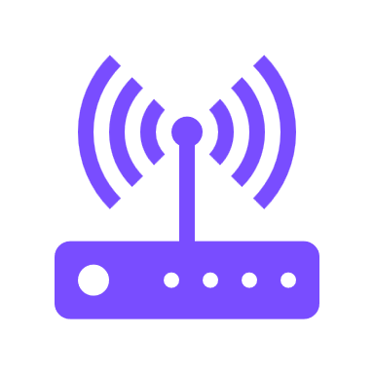

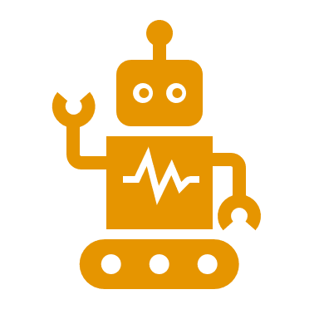




Proposed Solution
The proposed system is a smart building automation solution that integrates IoT technology for real-time monitoring and control of key safety and environmental parameters.
A central microcontroller (NodeMCU) collects sensor data and makes automated decisions such as triggering alerts, activating relays, or updating the user through mobile notifications.
The system is connected to the Blynk IoT platform, enabling users to:
  Monitor gas levels, temperature, humidity, motion, water levels, and fire risks remotely.
  Receive real-time alerts and control connected appliances from anywhere using a smartphone.
The solution is cost-effective, scalable, and easy to implement, making it ideal for residential and small-scale commercial buildings.
This automation system improves safety, energy efficiency, and convenience, addressing the limitations of manual monitoring and control systems.

Slide 6
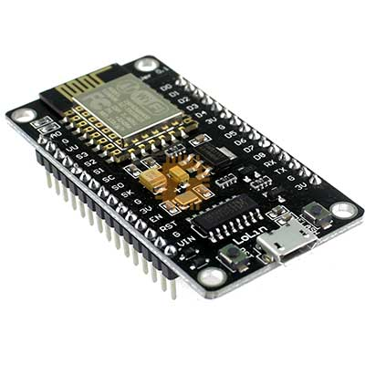
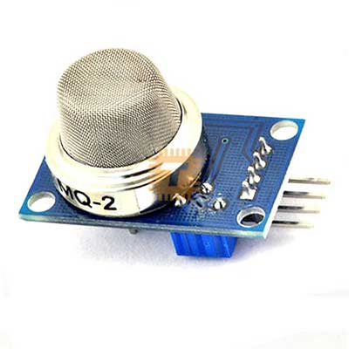
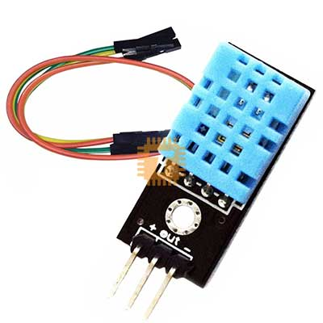
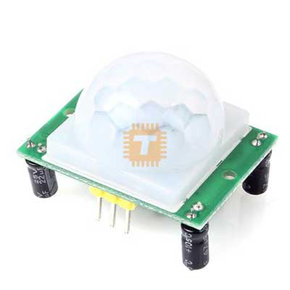
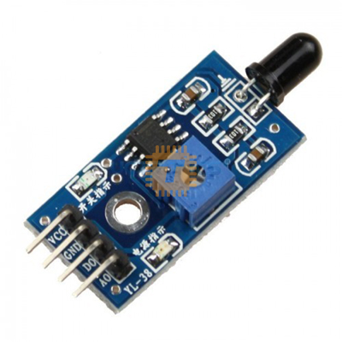
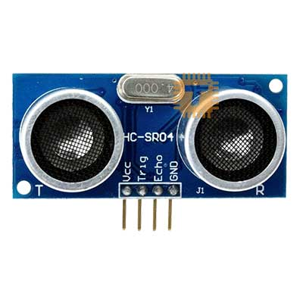
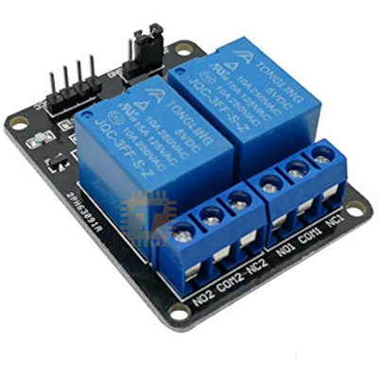
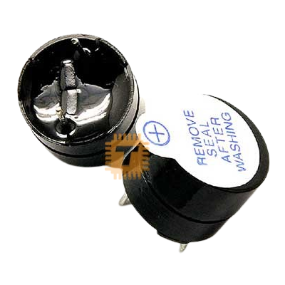
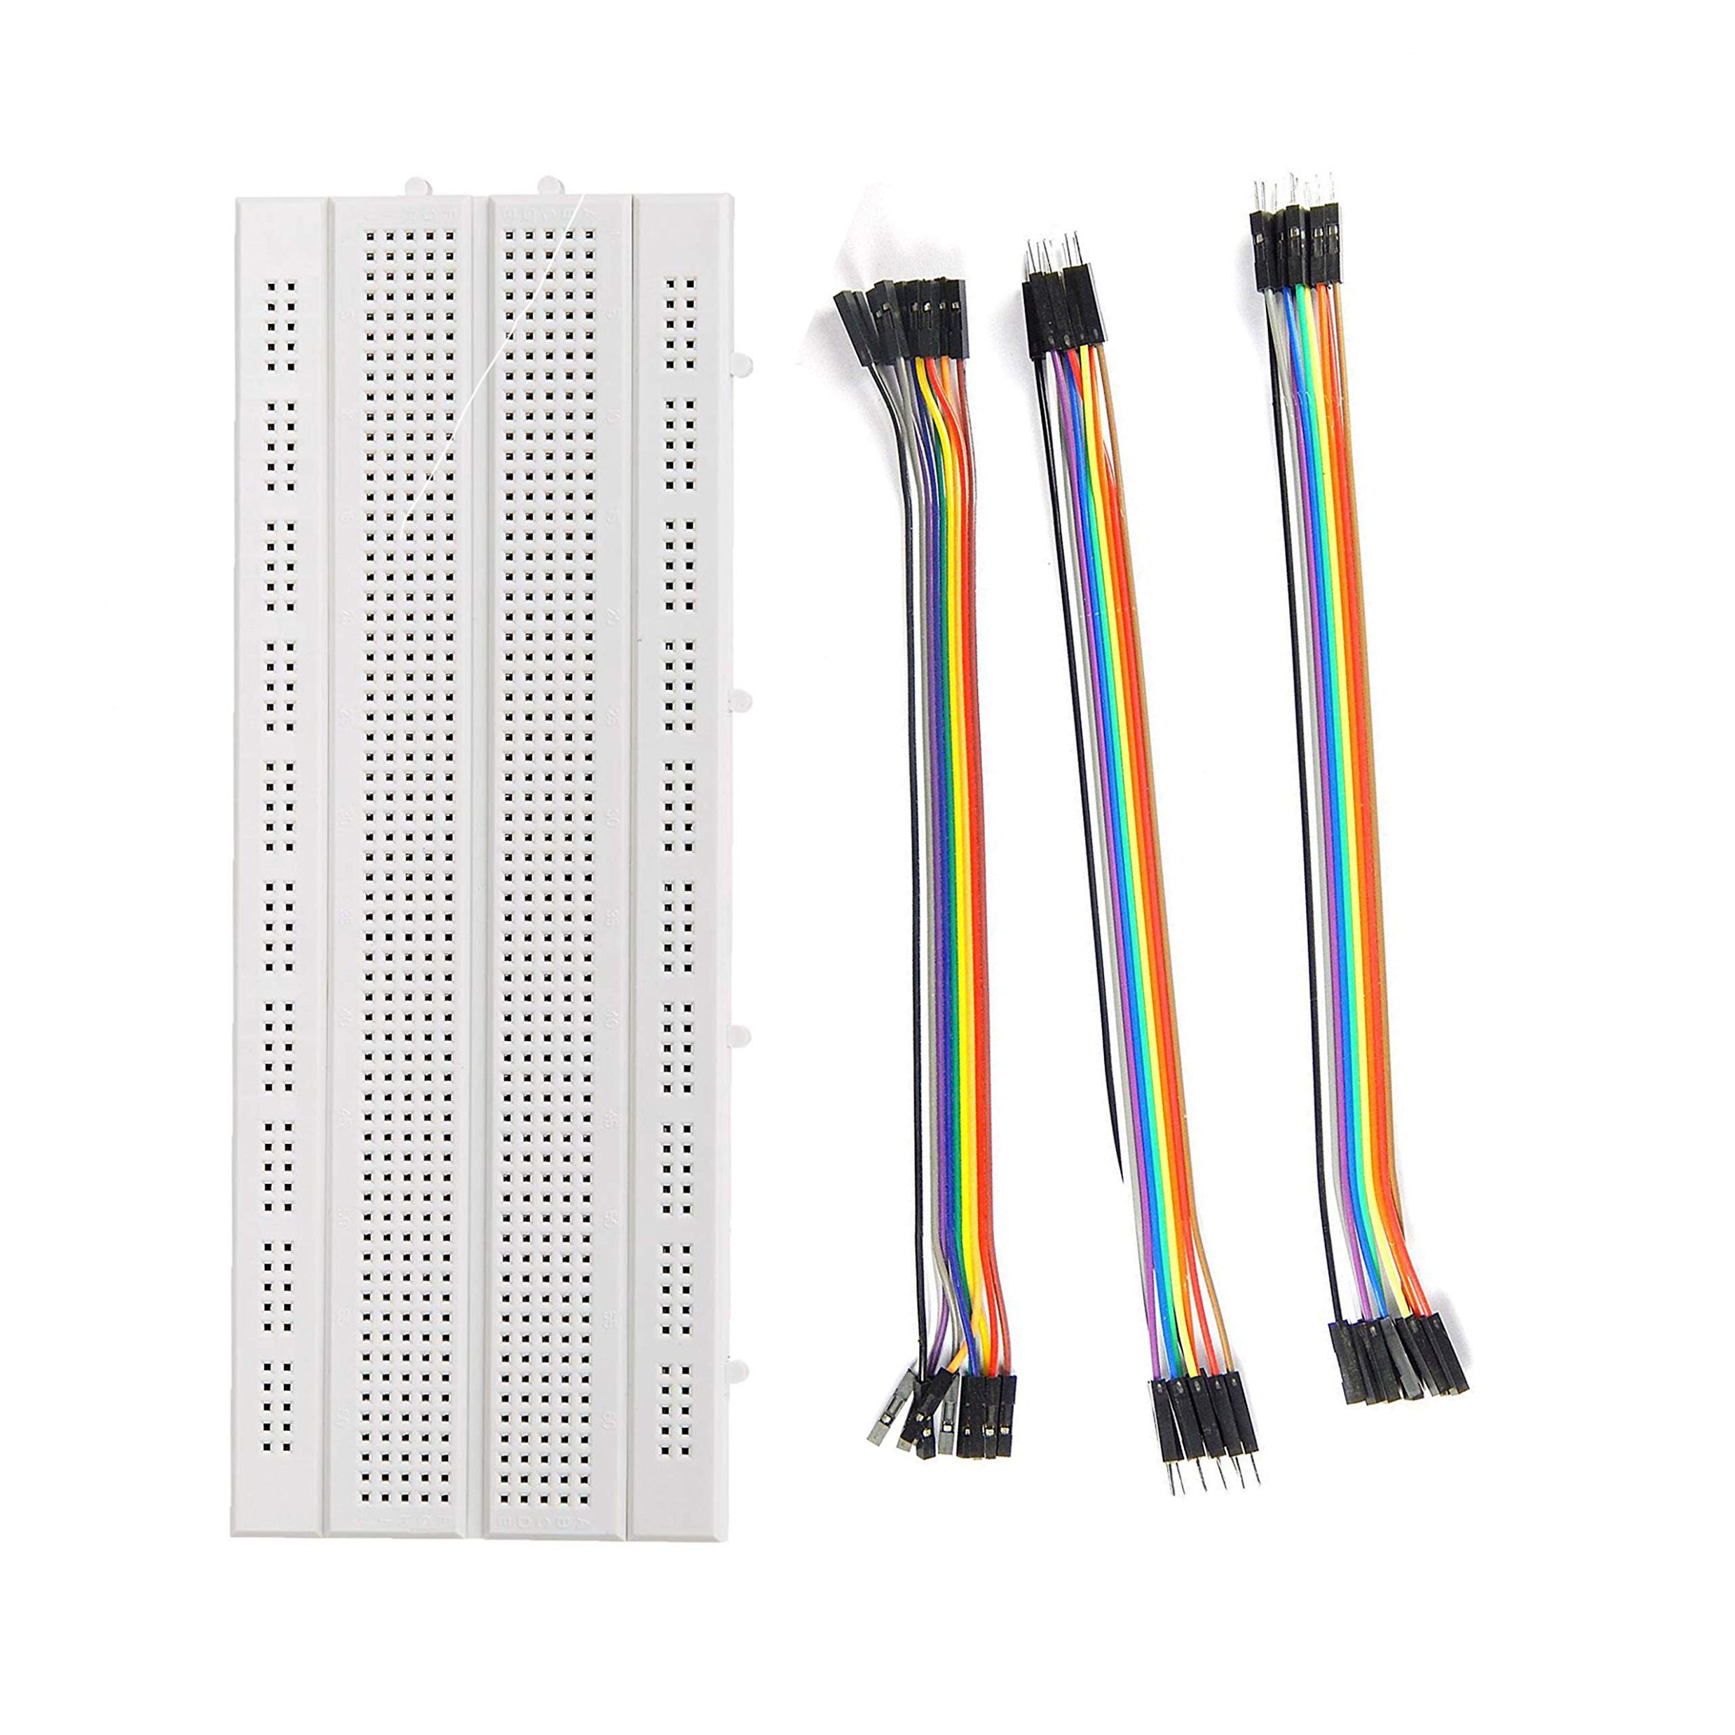
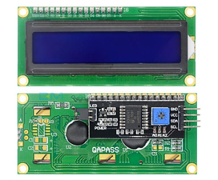
Hardware Requirements
MQ2 Gas Sensor
NodeMCU (ESP8266) – Dev Board
MQ2 - Gas Detection Modul
DHT11 Sensor – Temperature & Humidity
PIR Sensor – Motion detection
Flame Sensor - IR module
Ultrasonic Sensor
2-Channel Relay Module
Buzzer
LCD Display with I2C module
Breadboard & Jumper Wires

Slide 7


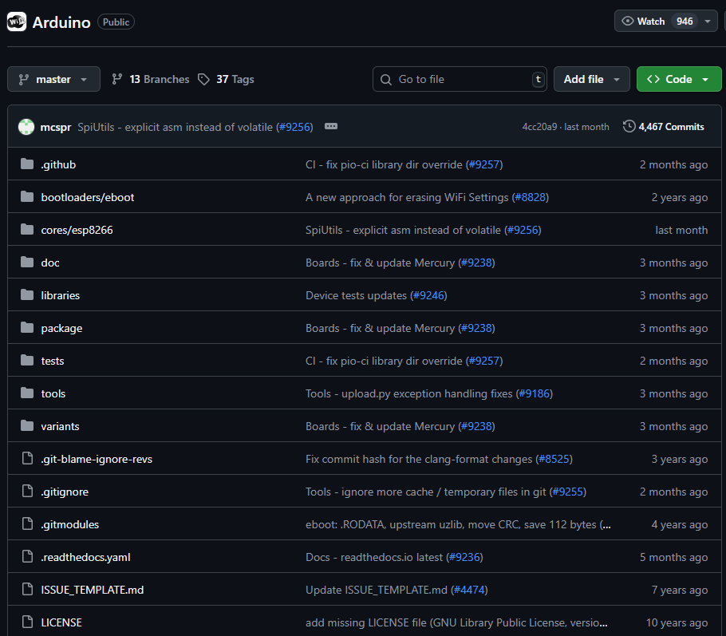

Software Requirements
MQ2 Gas Sensor
Arduino IDE – Code development and uploading
Blynk Application (Mobile) – IoT dashboard and control
Blynk Library – Integration with Arduino code
ESP8266 Board Package – For NodeMCU in Arduino IDE

Slide 8
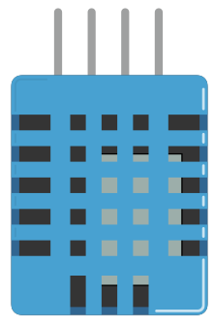
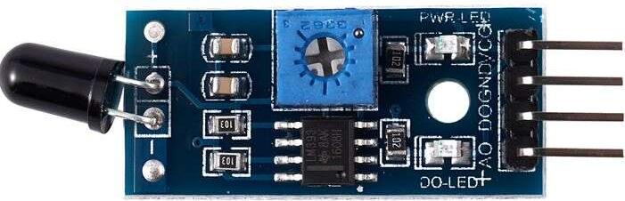
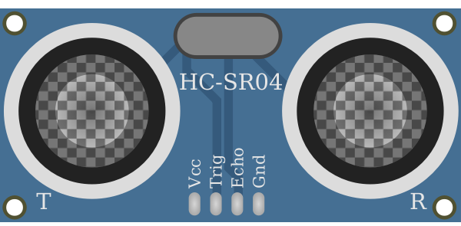

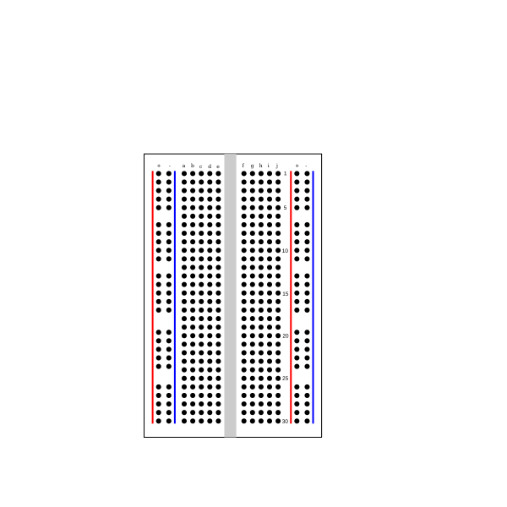

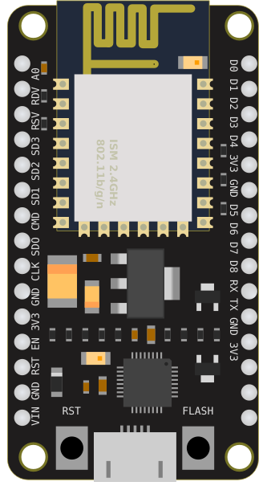


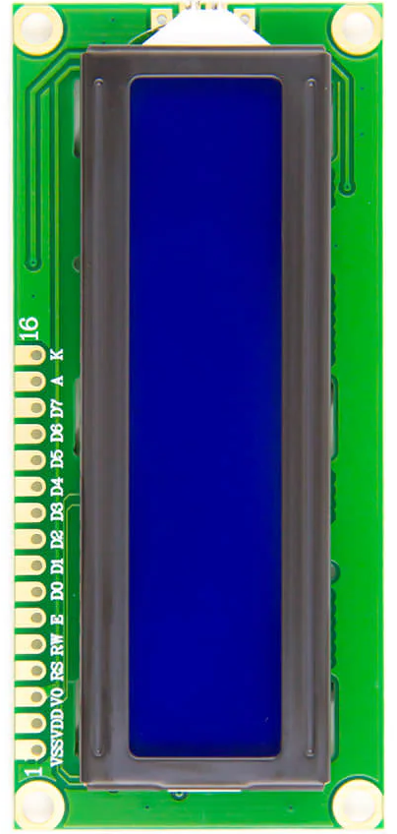
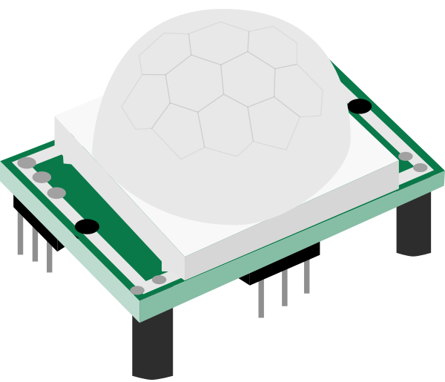
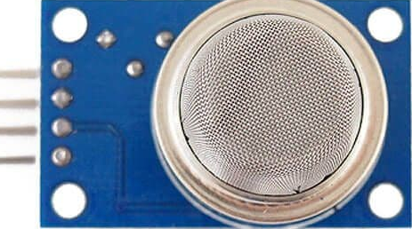
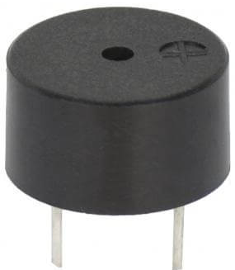
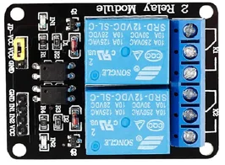
System Architecture
wire
wall
Ultra sonic
DH11
IR
ESP 8266
MQ2
Buzzer
PIR
Relay Module
LCD with I2C
BLYNK App

Slide 9
Timeline
Week | Tasks / Milestones
Week 1 | - Finalize system design - Gather components and set up NodeMCU - Install Arduino IDE and Blynk App
Week 2 | - Interface and test all sensors individually - Connect Blynk with NodeMCU - Build initial prototype on breadboard
Week 3 | - Integrate all components - Develop and test system logic - Configure alerts and control via Blynk
Week 4 | - Final testing and debugging - Create presentation and documentation - Prepare for project demonstration

Slide 10
Conclusion
The proposed IoT-based smart building system offers a reliable, affordable, and scalable solution for enhancing safety, efficiency, and comfort in modern buildings. By integrating real-time monitoring, automation, and remote control through the Blynk platform, this project demonstrates the potential of IoT in transforming traditional infrastructure into intelligent living environments.

Slide 11

Thank You !
Any Questions?

